Slide 1


Slide 2

Announcements
Buy your membership if you haven’t already (https://www.demontfortsu.com/organisation/dmuhackers/) Next week is the last free session
CTF Club will be on Wednesday - Soar Point @2pm (OSINT/Forensics challenges included)
Lanyards for sale still on SU website £3
Quiz is confirmed for the Tuesday 16th November 9pm at Duffy’s bar – Discounted drinks & Prizes – Bring friends
Christmas dinner needs to be booked soon, react to the announcement

Slide 3
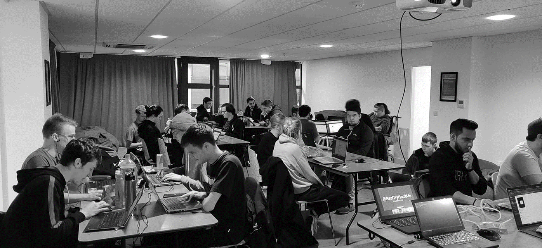


/dmuhackers
@dmuhackers
Open Source Intelligence (OSINT)

Slide 4


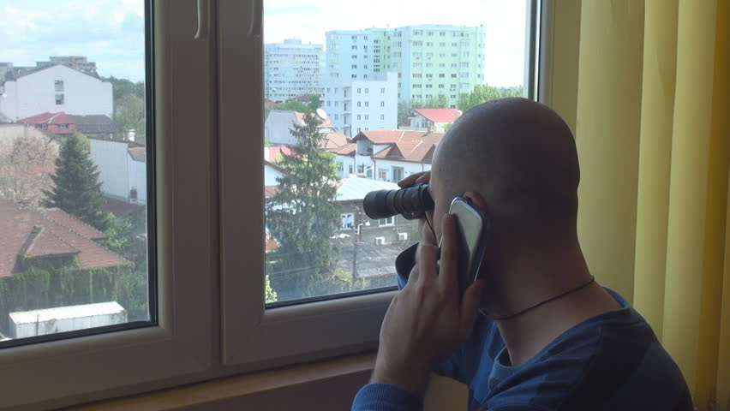
Disclaimer
Don’t be a creep

Slide 5
Overview
Logo Quiz
What is OSINT?
Google Dorks
Social Media Investigations
Network & Dark Web Investigations
Image Analysis
Geolocation
Practical Challenge
Pub

Slide 6













Logo Quiz

Slide 7
What is OSINT?
Open Source Intelligence (OSINT) is collection and analysis of data available via public means.
Google Dorks
Social Media Investigations
Geolocation/Geospatial mapping
Image analysis
Dark Web investigations
Literally anything available publicly on the internet

Slide 8

Google Dorks
Using extra operators on search engines to search effectively
intitle:
intext:
inurl:
“”
site:
filetype:
https://www.exploit-db.com/google-hacking-database

Slide 9

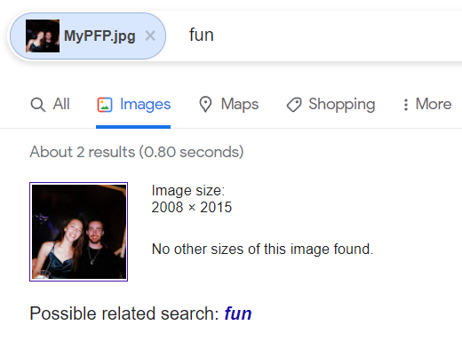
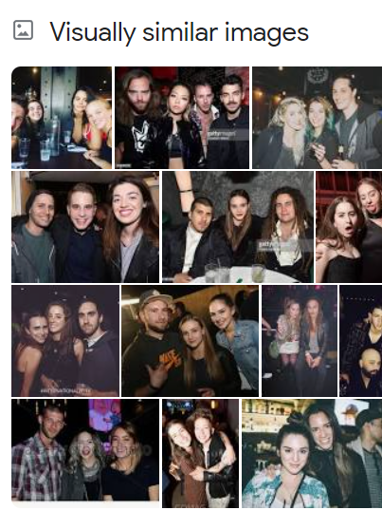
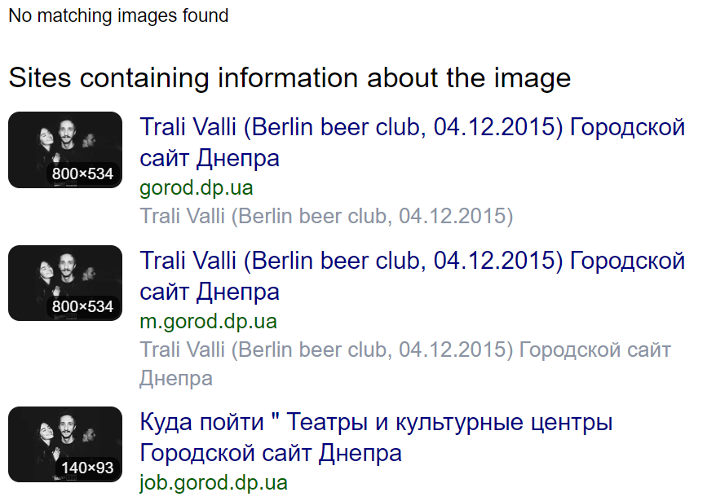
Social Media Investigations
Spiderfoot
Reverse image search profile pictures - YANDEX
Use the information you currently have to learn more
Incorporate the other parts of OSINT

Slide 10
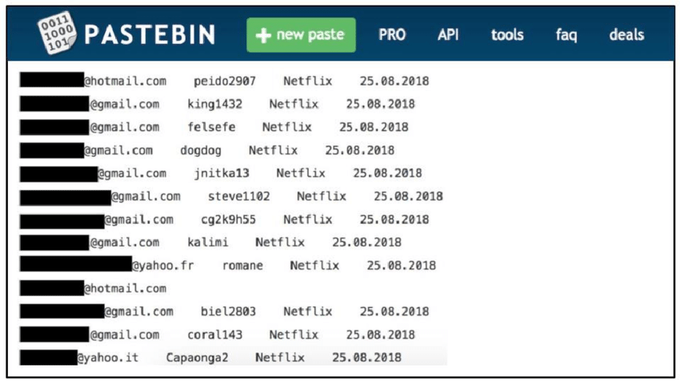
Network & Dark Web Investigations
Maltego
WHOIS
Wigle
Shodan
Spiderfoot
Pastebin
HaveIBeenPwned
DarkSearch
OnionSearch
Hunchly

Slide 11
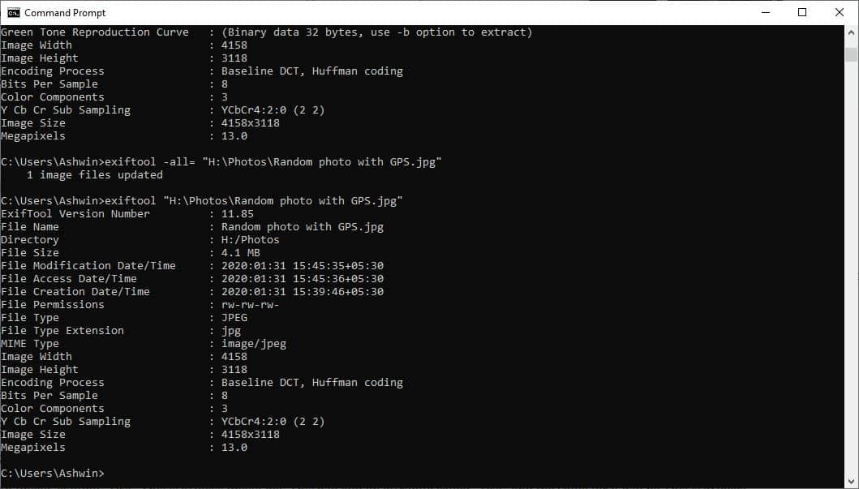
Image Analysis
Why are you analysing this image? Social media? Geolocation?
Yandex is your friend
Exiftool such as filetype, camera
used, time, direction, location,
editing software
Google Lens

Slide 12
Geolocation
Yandex, google maps satellite view, EO browser, google street view, google earth, mapillary, land registry/council websites, local news websites, translators, Instagram, snapchat.
Things to consider:
Provenance – Where did you get the photo? Where did they get it?
What side of the road are people driving on?
Can you see any signs? What language? Are the symbols unique to a certain country?
Are there any landmarks? Can you reverse the landmark on Yandex?
Whats the environment like? Can you map it on google earth?
Is there anything unique in the photo? Tiles, carpets, streetlamps, windows, pylons etc.
Confirm all hunches with hard evidence / another viewpoint

Slide 13
Challenge time
Questions?
Download link here

Slide 14
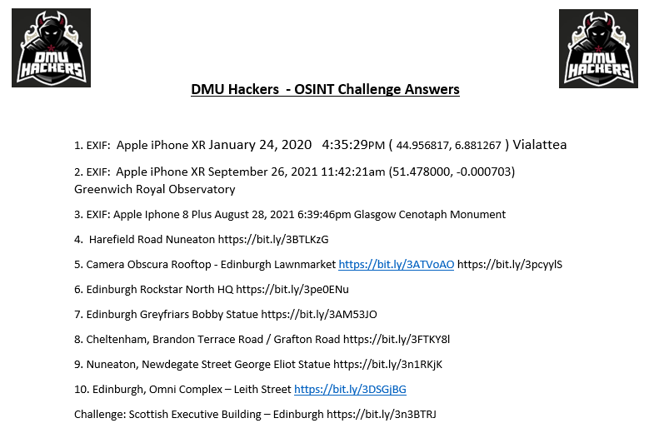
Challenge time - Answers

Slide 15



Questions?
@QuizTime
@Bitsyi__

